Slide 1
Modern Systems Analysis and Design Eighth Edition, Global Edition Joseph S. Valacich Joey F. George
Identifying and Selecting Systems Development Projects

Slide 2
Learning Objectives
Describe the project identification and selection process.
Describe corporate strategic planning and information systems planning process.
Describe the three classes of Internet electronic commerce applications: business-to-consumer, business-to-employee, and business-to-business.

Slide 3
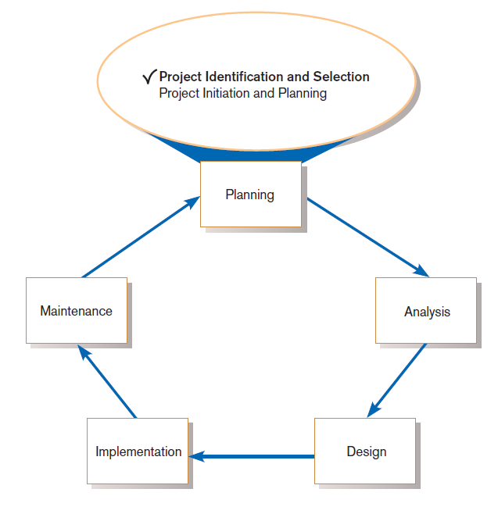
Identifying and Selecting Systems Development Projects
FIGURE 4-1
Systems development life cycle with
project identification and selection
highlighted
Three main steps:
Identifying potential development projects
Classifying and ranking IS development projects
Selecting IS development projects
Notes:
This chapter focuses on overall IS planning. Of all the possible projects to consider, we need to pick the ones that best fit our mission and objectives, and/or the ones that provide the best means to take advantage of opportunities or solve existing problems. We’ll look at several approaches and techniques.

Slide 4
The Process of Identifying and Selecting IS Development Projects
Identifying potential development projects
Identification from a stakeholder group
Each stakeholder group brings their own perspective and motivation to the IS decision.

Slide 5
The Process of Identifying and Selecting IS Development Projects (Cont.)
Top-down source are projects identified by top management or by a diverse steering committee.
Bottom-up source are project initiatives stemming from managers, business units, or the development group.
The process varies substantially across organizations.
Notes:
Different corporations have different cultures. Some cultures are more top-down, some are more “grassroots”, and others are a mix. The type of culture will probably influence the approach used to identify and select IS projects.

Slide 6
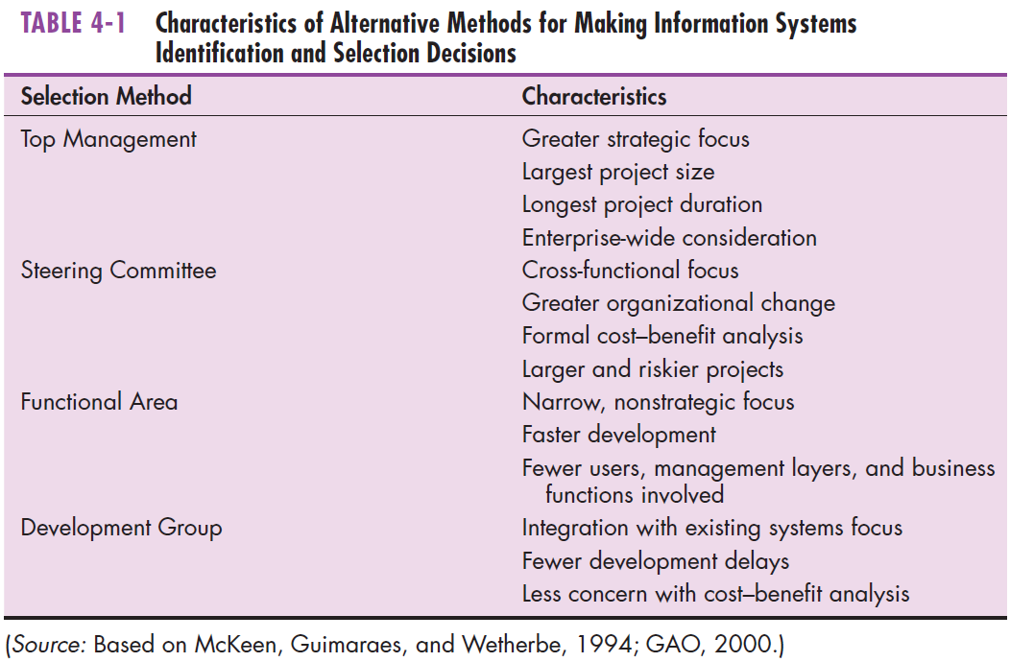
The Process of Identifying and Selecting IS Development Projects (Cont.)
Notes:
Each of these approaches to project selection emphasizes a different perspective or combination of perspectives.
If you recall from chapter 1, there are some factors that favor traditional SDLC and others that favor agile methodologies. Similarly, different factors favor one approach over others when it comes to identifying and selecting IS projects.

Slide 7
The Process of Identifying and Selecting IS Development Projects (Cont.)
Classifying and ranking IS development projects
Using value chain analysis or other evaluation criteria
Value chain analysis: Analyzing an organization’s activities to determine where value is added to products and/or services and the costs incurred for doing so; usually also includes a comparison with the activities, added value, and costs of other organizations for the purpose of making improvements in the organization’s operations and performance
Notes:
The concept of a value chain was coined by Michael Porter, a guru in competitive strategy. Porter’s value chain concept include five main business activities: inbound logistics, operations, outbound logistics, marketing and sales, and service. These are supported by internal activities pertaining to firm infrastructure, human resources, technology, and procurement. So, a value chain analysis to rank IS projects will focus on the project’s contribution to the main activities of the value chain.

Slide 8
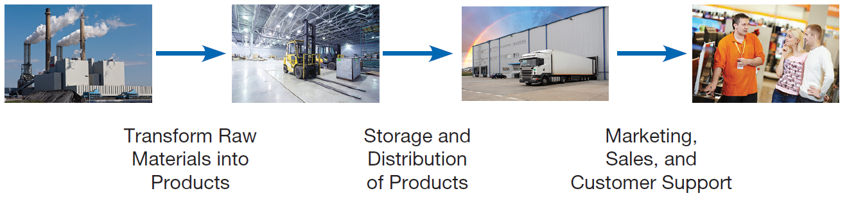
The Process of Identifying and Selecting IS Development Projects (Cont.)
FIGURE 4-2
Organizations can be thought of as a
value chain, transforming raw materials
into products for customers
Notes:
This is a picture of the value chain. It’s all about input, processing, and output, as you can see. Each phase of the value chain involves some business unit(s) of the organization. An information system will address the need of some element(s) of the value chain.

Slide 9
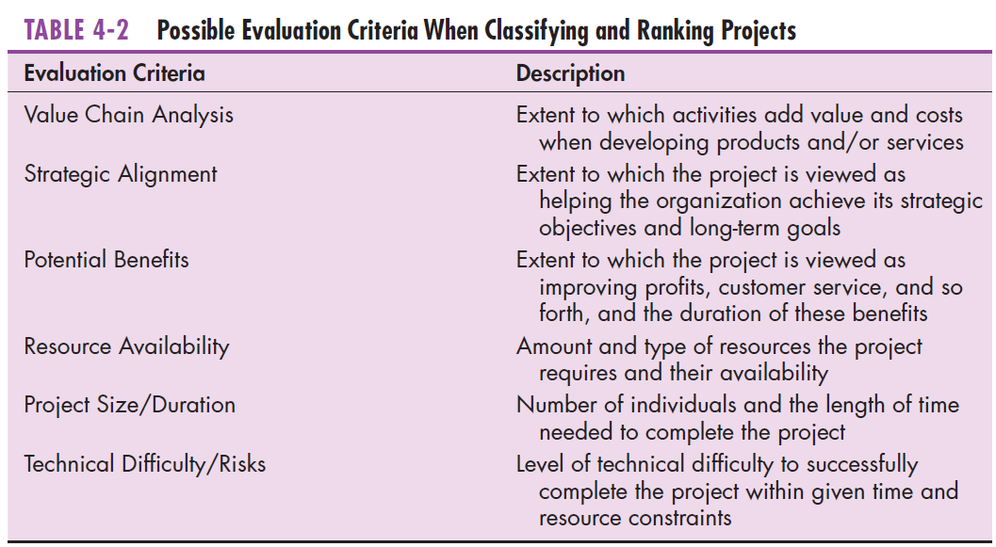
The Process of Identifying and Selecting IS Development Projects (Cont.)
Notes:
In addition to value chain analysis, there are other ways to characterize the evaluation criteria for project selection. Some of these have to do with cost/benefit analysis, some have to do with how realistic or doable the project is, some have to do with how important it is for the company’s strategic focus, some have to do with assessing risk. We’ll talk about all of these in the next few slides.

Slide 10
The Process of Identifying and Selecting IS Development Projects (Cont.)
Selecting IS development projects
Based on various factors
Both short- and long-term projects considered
Most likely to achieve business objectives selected
A very important and ongoing activity
Notes:
We just talked about the various factors for ranking and selection. Keep in mind that some projects are short-term and low-risk, so the evaluation is simpler with these.

Slide 11
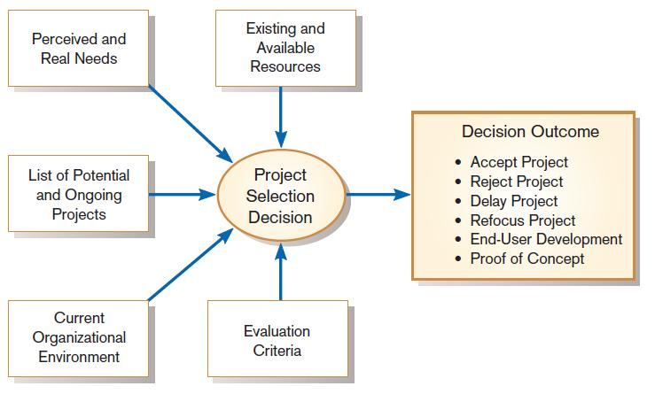
The Process of Identifying and Selecting IS Development Projects (Cont.)
FIGURE 4-3
Project selection decisions must consider numerous factors and can have numerous outcomes
Notes:
This figure illustrates the various factors involved. And a decision could be delayed, as we see here. If you decide not to pursue a project now, then it is possible that you may later decide to do it. Also, the “proof of concept” idea can be applied. In this case, we may build a prototype or mock-up in order to make a final decision.

Slide 12
The Process of Identifying and Selecting IS Development Projects (Cont.)
One method for deciding among different projects or alternative designs:
For each requirement or constraint:
Score = weight X rating
Each alternative: sum scores across requirements/constraints
Alternative with highest score wins
Notes:
Typically, the weight refers to the importance of a criterion (requirement or constraint). The rating refers to the alternative design’s promise of successfully satisfying the requirement. This is a classic case of multicriteria analysis. This approach is used in a lot of decision support systems, and sometimes DSSs can be constructed and used to help with IS project selection.

Slide 13
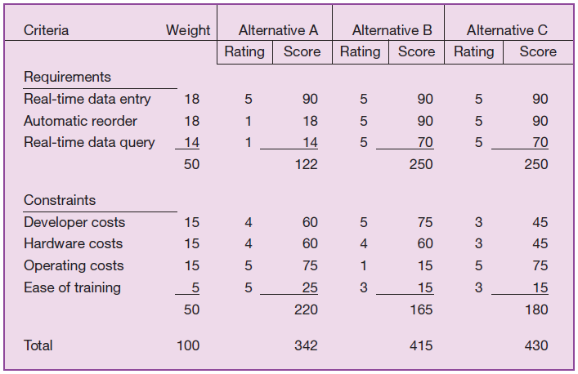
The Process of Identifying and Selecting IS Development Projects (Cont.)
FIGURE 4-4
Alternative projects and system design
decisions can be assisted using weighted
multicriteria analysis
Notes:
You can imagine implementing this in a spreadsheet. The Score columns will multiply rating (for the alternative) times weight (for the requirement or constraint). By playing with the weights, you can play “what-if” games to see how your decisions on “what’s important” affects your decision of which alternative to select.

Slide 14
Deliverables and Outcomes
Primary deliverable from the first part of the planning phase is a schedule of specific IS development projects.
Outcome of the next part of the planning phase—project initiation and planning—is the assurance that careful consideration was given to project selection and each project can help the organization reach its goals.

Slide 15
Deliverables and Outcomes (Cont.)
Incremental commitment: a strategy in systems analysis and design in which the project is reviewed after each phase and continuation of the project is rejustified
Notes:
The traditional SDLC can be considered an example of incremental commitment. The initiation phase involves relatively low commitment and effort. The analysis phase increases the effort and commitment. And the design and implementation phases typically involve the most intense commitment.
Figure 1-11 of chapter 1 nicely illustrates this incremental commitment idea in an OOSAD context. It shows time and resource commitments for different phases of the life cycle (inception, elaboration, construction, and transition).

Slide 16
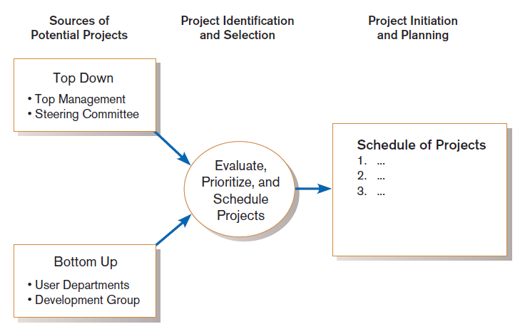
Deliverables and Outcomes (Cont.)
Figure 4-5
Information systems development projects come from both top-down and bottom-up initiatives.
Notes:
Recall that our current topic is project evaluation and selection. This is part of the IS planning process. Each phase of the overall SDLC, and each step of the planning phase, has a defined deliverable. For project evaluation/selection, the output is the selection of projects (and their priorities) that have been accepted.
Once a project has been accepted, the project initiation phase begins. This will be discussed more in chapter 5.

Slide 17
Corporate and Information Systems Planning
To benefit from a planning-based approach for identifying and selecting projects, an organization must:
Analyze its information needs thoroughly.
Plan its projects carefully.
Notes:
Organizations have not traditionally used a systematic planning process when determining how to allocate IS resources. Instead, projects have often resulted from attempts to solve isolated organizational problems.
Organizations have asked this question: “What procedure (application program) is required to solve this particular problem as it exists today?”
In addition, they should also ask: “What information (or data) requirements will satisfy the decision-making needs or business processes of the enterprise today and well into the future?”
In other words, the planning approach is proactive and forward-looking, whereas the more traditional habitual approach is reactive and driven by problems that come up.

Slide 18
Reasons for Importance of Improved Planning
Increasing cost of information systems (40% of organizational expense)
Lack of cross-organizational applications and systems
Systems don’t address critical strategic problems
Too much data redundancy, lack of data quality
High system maintenance costs
Long application backlogs
Notes:
The reactive approach doesn’t work as well. Here are some reasons for taking a more meticulous planning approach, and to align this with the corporate strategic planning process.

Slide 19
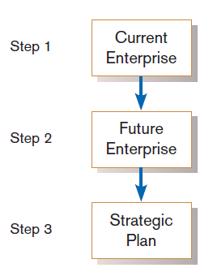
Corporate Strategic Planning
Ongoing process that defines mission, objectives, and strategies of an organization
Corporate strategy involves:
Mission statement
Objective statements
Description of competitive strategy
Figure 4-6
Corporate strategic planning is a three step
Process.

Slide 20
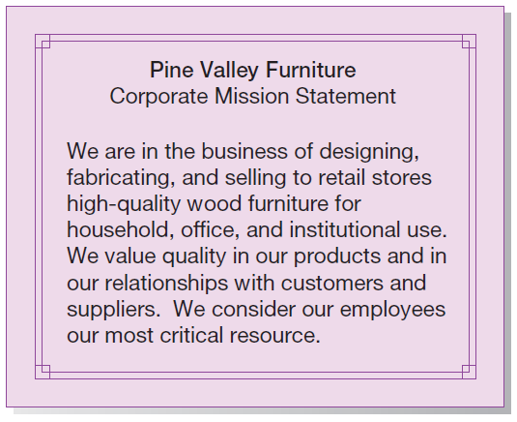
Corporate Strategic Planning (Cont.)
Mission statement: a statement that makes it clear what business a company is in
Figure 4-7
Mission statement (Pine Valley Furniture)
Notes:
The mission statement should be short and descriptive, easy to articulate, understand and remember. It should give a good idea of what is most important for the company.
For example, this mission statement may imply that a sales information system geared to individual customers is less important than a system geared to customers who are retail stores. The primary customers are retail stores, not individual customers. Also, the mission statement considers employees to be PVF’s most critical resource, which may imply motivation for enhancing the human resources systems.

Slide 21
Corporate Strategic Planning (Cont.)
Objective statement: a series of statements that express an organization’s qualitative and quantitative goals for reaching a desired future position
Sometimes called “critical success factors”
Notes:
The objective statement goes into more detail than the mission statement, but is guided by the mission. Objectives refer to the “broad and timeless” goals of the organization.

Slide 22
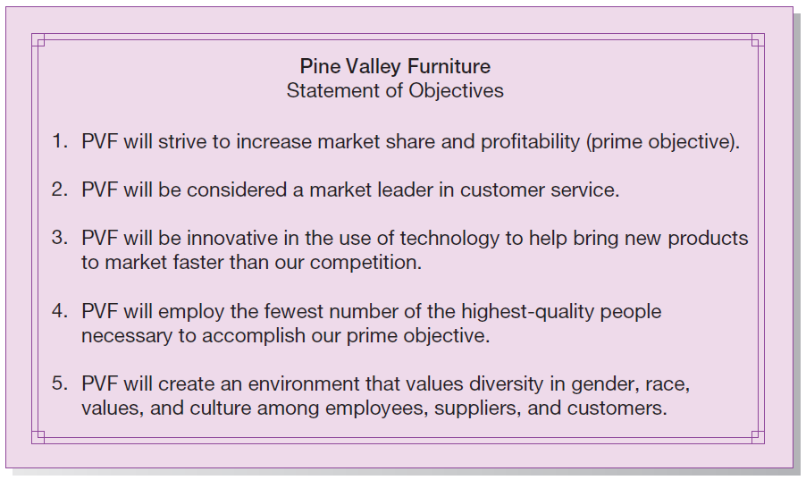
Corporate Strategic Planning (Cont.)
FIGURE 4-8
Statement of Corporate Objectives
(Pine Valley Furniture)
Notes:
Here is PVF’s statement of objectives. Here again we see some implications for what types of information systems are important. For example, customer service and market share are top objectives. This may support an order tracking system in order to improve customer service.

Slide 23
Corporate Strategic Planning (Cont.)
Competitive strategy: the method by which an organization attempts to achieve its mission and objectives
Main types:
Low-cost producer
Product differentiation
Product focus or niche
Notes:
The competitive strategies listed here were elaborated by Michael Porter in his 1980 book “Competitive Strategy: Techniques for Analyzing Industries and Competitors”.

Slide 24
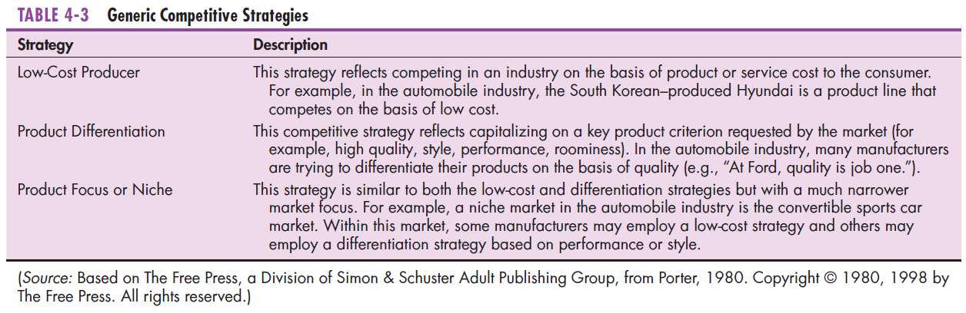
Corporate Strategic Planning (Cont.)
Notes:
As you can see, a low cost strategy is quite different from a product differentiation strategy. Different strategies will result in different focus of effort within the organization. The competitive strategy also has an impact on IS project selection and IS planning in general.
Actually, the competitive strategy helps to define details of a company’s value chain, which in turn affects information systems decisions.

Slide 25
Information Systems Planning (ISP)
An orderly means of assessing the information needs of an organization and defining the systems, databases, and technologies that will best meet those needs
Must model current and future organization informational needs and develop strategies and project plans to migrate the current information systems and technologies to their desired future state
ISP must be done in accordance with the organization’s mission, objectives, and competitive strategy.

Slide 26
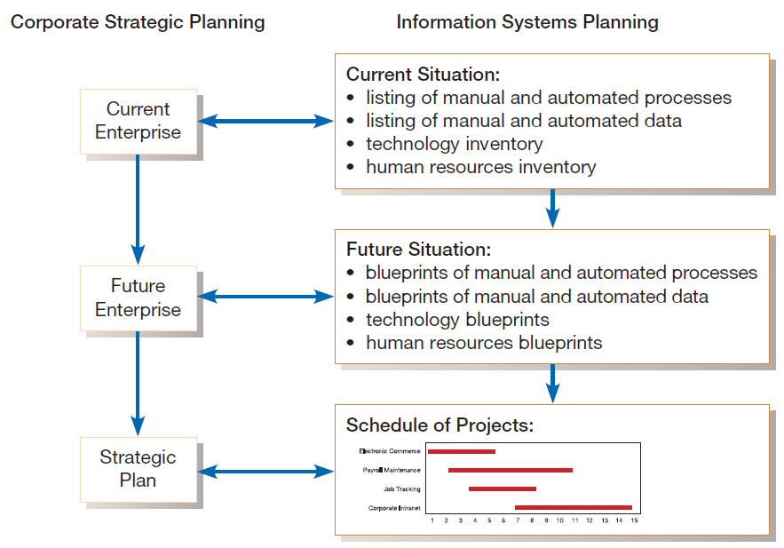
Information Systems Planning (Cont.)
FIGURE 4-10
Parallel activities of corporate strategic planning and information systems planning
Notes:
This figure shows the relationship between overall corporate strategic planning and information systems planning.
In both cases, there is a tradeoff between top-down planning and bottom-up planning. Each perspective brings useful information to the decision-making process. Recall from Figure 4-5 that we saw both top-down and bottom-up sources for potential projects. The top-down and bottom-up dichotomy also works with respect to IS planning as a whole.
We see here three main steps in the corporate and IS plan. First is to describe the current situation which gives our present state of affairs. Then you describe the “target situation”, which gives our desired state. Finally, we develop a strategy to transition from the current to the target situation.

Slide 27
Information Systems Planning (Cont.)
Top-down planning attempts to gain a broad understanding of information system needs of the entire organization and offers:
Broader perspective.
Improved integration.
Improved management support.
Better understanding.
Notes:
You can see advantages of top-down planning, which gives a more holistic and enterprise-wide view of the IS needs. This advantage, though, comes with costs. It’s harder to analyze the information needs of the entire enterprise than it is for a small group.

Slide 28
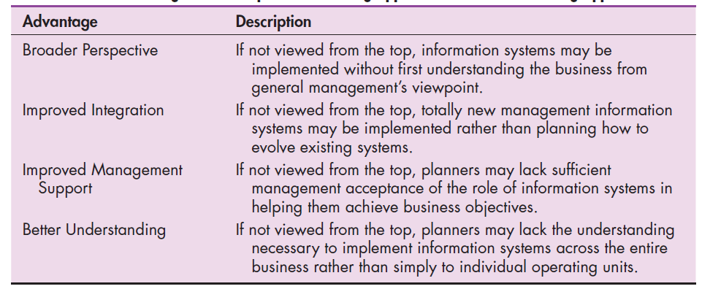
Information Systems Planning (Cont.)
Top-down planning
Notes:
You can see advantages of top-down planning, which gives a more holistic and enterprise-wide view of the IS needs. This advantage, though, comes with costs. It’s harder to analyze the information needs of the entire enterprise than it is for a small group.

Slide 29
Information Systems Planning (Cont.)
Bottom-up planning identifies IS development projects based on solving specific operational business problems or taking advantage of specific opportunities.
Can be faster and less costly, so may be beneficial in certain circumstances.
Notes:
So, the bottom-up planning approach is another option. This one is more opportunistic, and less locked in with pre-established corporate mission and objectives.
A company is probably going to use a mix of both top-down and bottom-up planning.

Slide 30
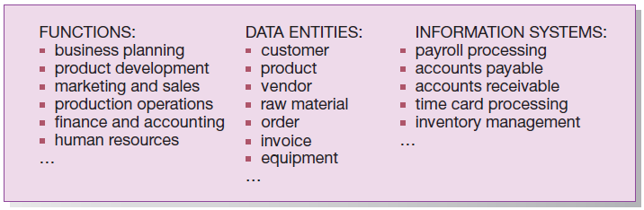
Information Systems Planning (Cont.)
FIGURE 4-11
Information systems planning information
(Pine Valley Furniture)
Notes:
Regardless of whether we use a top-down or bottom-up approach, there will be some key dimensions to consider. These include functions, data entities, locations, units, processes, objectives, and other key items. These can be displayed in a variety of graphical forms, such as organization charts or matrices, in order to get a better idea of the relationships between them. We’ll see some examples of this in the next few slides.

Slide 31
Information Systems Planning (Cont.)
Functional Decomposition: breaking high-level abstract information into smaller units for more detailed planning
Notes:
Functional decomposition is a common means of modeling the tasks that an information system should be able to do.

Slide 32
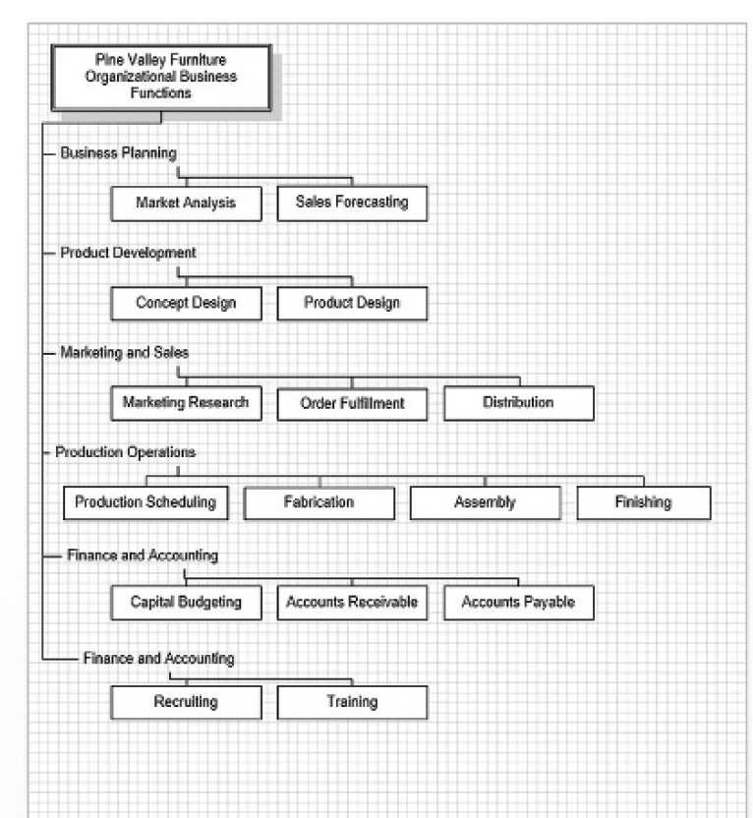
Information Systems Planning (Cont.)
FIGURE 4-12
Functional decomposition of information
systems planning information (Pine Valley Furniture)
(Source: Microsoft Corporation.)
Notes:
This is a Microsoft Visio diagram showing functional decomposition. Recall from previous chapters that we’ve seen the use of Microsoft Project for project management and Microsoft Excel for .budgeting. Visio provides a means to display information in a variety of useful graphical formats.

Slide 33
Information Systems Planning (Cont.)
IS planning matrices describe relationships between pairs of organizational elements (location, function, business unit, objective, process, data, information system).

Slide 34
Types of Planning Matrices
Location-to-Function
Location-to-Unit
Unit-to-Function
Function-to-Objective
Function-to-Process
Function-to-Data Entity
Process-to-Data Entity
Process-to-Information System
Data Entity-to-Information System
Information System-to-Objective
Notes:
Each of these matrices displays the relationships between pairs of factors.

Slide 35
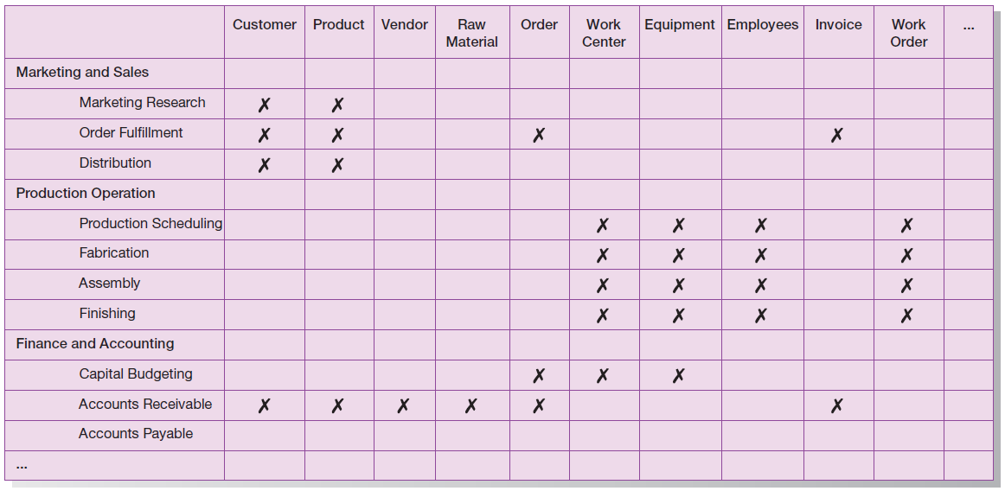
Information Systems Planning (Cont.)
FIGURE 4-13
Data Entity-to-Function matrix (Pine Valley Furniture)
Notes:
Perhaps the most common matrix matches functions with data entities. Here you can see that order fulfillment needs customer, product, order, and invoice data. We can also see that both customer and product data are shared by market research, order fulfillment, distribution, and accounts receivable.
By constructing matrices like this, a company can come up with a better idea of who has (or needs) what kind of access to what data.
Note that these planning matrices can be used both for describing the current situation and for describing the hoped-for target situation. A data entity – to – function matrix may look considerably different in the current situation compared to the target situation.

Slide 36
Making Sense of the Matrices
IS planning takes place prior to project identification and selection
“Behind the scenes” analysis
Matrices: as-is (current) and to-be (future, target)
CASE tools help via:
Managing information
Matrix construction
Matrix analysis (affinity clustering)

Slide 37
Affinity Clustering
Arranging planning matrix information so that clusters of information with a predetermined level or type of affinity are placed next to each other on a matrix report
Affinity – the extent to which information holds things in common
Example: Function – to – Data entity matrix
Functions using similar data entities placed in adjacent rows
Data entities used in common by processes in adjacent columns
Notes:
Let’s look at figure 4-13 again. You can see affinity between the production scheduling, fabrication, assembly, and finishing functions. Each of these use common data elements: work center, equipment, employees, and work order.
To the degree that you can do this with all clusters of function/data element affinities, the matrix will visually show “natural groupings”, and CASE tools can help with this.

Slide 38
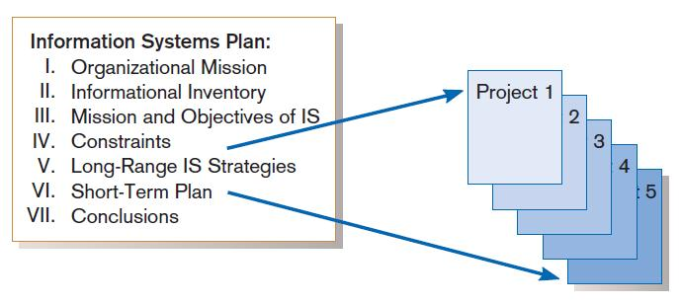
Information Systems (IS) Plan
FIGURE 4-16
Systems development projects flow from the information systems plan.
Notes:
The IS plan builds on the corporate plan, and helps to establish the priorities of IS development projects to pursue. We will now discuss each of the components of an IS plan.

Slide 39
IS Plan Components
Organizational Mission, Objectives, and Strategy
Brief description of mission, objectives, and strategy of the organization. The current and future views of the company are also briefly presented
Information Inventory
Summary of processes, functions, data entities, and information needs of the enterprise
Notes:
Here we see that the IS plan is driven by organization mission and objectives.
We also see that the planning matrices we discussed are important for establishing the information inventory.

Slide 40
IS Plan Components (Cont.)
Mission and Objectives of IS
Primary role IS will play in the organization to transform enterprise from current to future state
Constraints on IS Development
Limitations imposed by technology and current levels of financial, technical, and personnel resources
Notes:
Obviously, the IS mission and objectives should be congruent with the overall corporate mission and objectives.
IS people are also best able to perform a “reality check” of the corporations desires for IS services. This is where feasibility analysis comes into play.

Slide 41
IS Plan Components (Cont.)
Systems Needs and IS Strategy
Summarize overall information systems needs in the company and set long-term (2-5 year) strategies for filling the needs
Short Term Plan
Detailed inventory of present projects and systems and detailed plan for the current year
Notes:
You can think of the IS Plan as a subset of the overall corporate plan. Other business functions (operations, human resources, marketing, finance, etc.) will have similar plans, all governed by the corporate mission and objectives.

Slide 42
IS Plan Components (Cont.)
Conclusions
Unknown but likely events that can affect the plan, presently known business change elements and their impact on the plan
Notes:
This final item is important, trying to anticipate possible scenarios and the IS unit’s responses to them. In a rapidly changing technology environment, it’s important to consider these uncertainties.

Slide 43
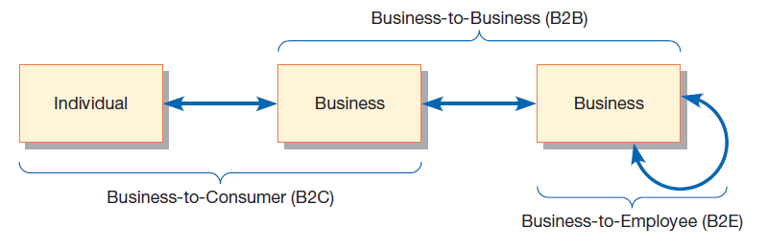
Electronic Commerce: Identifying and Selecting Projects
Figure 4-17
Three possible modes of electronic
commerce
Notes:
Our last topic is e-commerce project identification and selection.
These are the three main types of e-commerce. The next slide gives some definitions.

Slide 44
Electronic Commerce Applications and Internet Basics (Cont.)
Business-to-consumer (B2C): electronic commerce between businesses and consumers
Business-to-business (B2B): electronic commerce between business partners, such as suppliers and intermediaries
Business-to-employee (B2E): electronic commerce between businesses and their employees
Notes:
When you use Amazon.com to purchase a product, you are using a B2C application. If Walmart’s warehouse communicates with CocaCola’s distribution center to insure that Walmart maintains enough inventory, this is an example of B2B. And if, as an employee, you directly set up W4 and benefits preferences thought the HR system, you are doing B2E.

Slide 45
Electronic Commerce Applications and Internet Basics
Internet: a large worldwide network of networks that use a common protocol to communicate with each other
Electronic Commerce (EC): Internet-based communication to support day-to-day business activities
Electronic data interchange (EDI): the use of telecommunications technologies to directly transfer business documents between organizations
Notes:
All of this is possible because of the Internet. Large-scale e-commerce requires a world-wide network.
EDI is usually done with some standard communications and data-sharing protocols. A very common current protocol is XML.

Slide 46
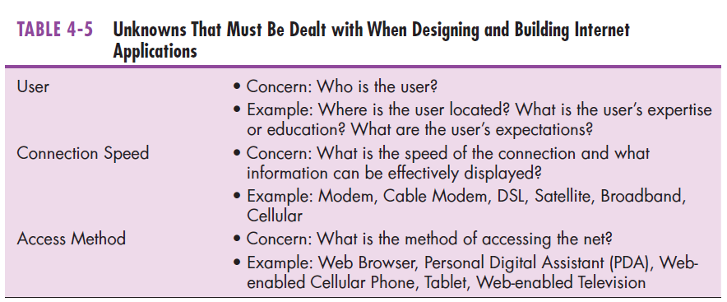
Electronic Commerce Applications and Internet Basics (Cont.)
Notes:
In many ways, e-commerce project selection is just like any other type of project selection. But there are additional factors when dealing with Internet-based applications.
A good IS plan will work to ensure that the e-commerce application integrates well with other elements of the corporate IS. For example, PVF may want to create an e-commerce “WebStore”. If so, it should integrate well with their Purchasing Fulfilment and Customer Tracking systems.

Slide 47
Summary
In this chapter you learned how to:
Describe the project identification and selection process.
Describe corporate strategic planning and information systems planning process.
Describe the three classes of Internet electronic commerce applications: business-to-consumer, business-to-employee, and business-to-business.

